Slide 1
Object Oriented Programming
CS IS F213 and CS IS C313

Slide 2
Computer Programming
The history of computer programming is a steady move away from machine-oriented views of programming towards concepts and metaphors that more closely reflect the way in which we ourselves understand the world

Slide 3
Programming progression…
Programming has progressed through:
  machine code
  assembly language
  machine-independent programming languages
  procedures & functions
  objects
Notes:
This progression is not a matter of “intrinsic power”
Anything you can do with a minimally capable computer language, you can theoretically do with any other minimally capable computer language
But that is like saying a shovel is theoretically as capable as a tractor. In practice, using a shovel might make things very hard…

Slide 4
History of Object-Oriented Programming
Started out for simulation of complex man-machine systems, but was soon realized that it was suitable for all complex programming projects
SIMULA I (1962-65) and Simula 67 (1967) were the first two object-oriented languages
  Developed at the Norwegian Computing Center, Oslo, Norway by Ole-Johan Dahl and Kristen Nygaard

Slide 5
Object-Oriented Programming in Industry
Large projects are routinely programmed using object-oriented languages nowadays
MS-Windows and applications in MS-Office – all developed using object-oriented languages

Slide 6
As a programmer
Object-oriented programming provides a superior way of organizing programming projects
  It encourages a high degree of modularity in programming, making large projects easier to implement
  It provides powerful techniques like inheritance and polymorphism to help organize and reuse code
Increase
  programmer productivity
  quality of software
  understandability of software
  lifetime of software

Slide 7
Procedural Approach
Focus is on procedures
All data is shared: no protection
More difficult to modify
Hard to manage complexity

Slide 8

OOP: Mapping the world to software
Objects in the problem domain are mapped to objects in software
Data and operations are grouped together
0110100
011101
010101
10011
1110101
11101
11010
10101

Slide 9
Old Paradigm
Computer system consists of data and programs.
Programs manipulate data.
Programs organized by
  functional decomposition
  dataflow
  modules

Slide 10
New Paradigm
Computer system consists of a set of objects.
Objects are responsible for knowing and doing certain things.
Objects collaborate to carry out their responsibilities.
Programs organized by classes, inheritance hierarchies and subsystems

Slide 11
The 3 Principles of Object Oriented Programming
Encapsulation
  Control access to the data and methods
Inheritance
  Inherit the data and methods of parent class
Polymorphism
Shape
getArea()
Shape Obj = new Ellipse();
Obj.getArea();
Ellipse
Rectangle
Triangle
Which Area?
getArea()
getArea()
getArea()

Slide 12
Agenda
Object
Object Collaboration
Message
Class

Slide 13
OO Basics - Object
What Is an Object ?
Objects are key to understanding object-oriented technology.
You can see many examples of real-world objects :-
your dog, your desk, your television set, your bicycle.

Slide 14
OO Basics - Object
Real-world objects share two characteristics :-
They all have state and behavior.
For example,
dogs have state (name, color, breed, hungry)
and behavior (barking, fetching, wagging tail).
Bicycles have state (current gear, current pedal cadence, two wheels, number of gears)
and behavior (braking, accelerating, slowing down, changing gears).

Slide 15
OO Basics - Object
Software objects are modeled after real-world objects in that they too have state and behavior.
A software object maintains its state in one or more variables.
A variable is an item of data named by an identifier.
A software object implements its behavior with methods.
A method is a function (subroutine) associated with an object.

Slide 16
OO Basics - Object
You can represent real-world objects by using software objects.
You might want to represent a real-world bicycle as a software object in the program that controls an electronic exercise bike.
You can also use software objects to model abstract concepts.
For example, an event is a common object used in window systems to represent the action of a user pressing a mouse button or a key on the keyboard.

Slide 17
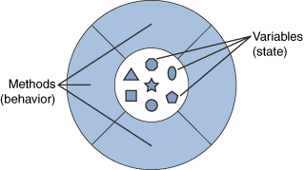
OO Basics - Object
A software object.
Everything the software object knows (state) and can do (behavior) is expressed by the variables and the methods within that object.

Slide 18
OO Basics - Object
A software object that models your real-world bicycle would have variables that indicate the bicycle's current state :-
Its speed is 18 mph, its pedal cadence is 90 rpm, and its current gear is 5th.
These variables are formally known as instance variables because they contain the state for a particular bicycle object; in object-oriented terminology, a particular object is called an instance.

Slide 19
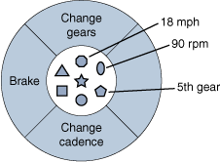
OO Basics - Object
The following figure illustrates a bicycle modeled as a software object.

Slide 20
OO Basics - Object
In addition to its variables, the software bicycle would also have methods to brake, change the pedal cadence, and change gears.
(It would not have a method for changing its speed because the bike's speed is just a side effect of which gear it's in and how fast the rider is pedaling.)
These methods are known formally as instance methods because they inspect or change the state of a particular bicycle instance.

Slide 21
OO Basics - Message
Software objects interact and communicate with each other using messages.

Slide 22
OO Basics - Message
What Is a Message?
A single object alone generally is not very useful.
Instead, an object usually appears as a component of a larger program or application that contains many other objects.
Through the interaction of these objects, programmers achieve higher-order functionality and more complex behavior.
Your bicycle hanging from a hook in the garage is just a bunch of metal and rubber; by itself, it is incapable of any activity; the bicycle is useful only when another object (you) interacts with it (by pedaling).

Slide 23
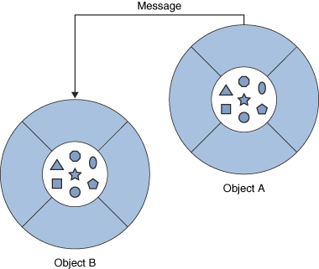
OO Basics - Message
Software objects interact and communicate with each other by sending messages to each other.
When object A wants object B to perform one of B's methods, object A sends a message to object B

Slide 24
OO Basics - Message
Sometimes, the receiving object needs more information so that it knows exactly what to do :-
for example, when you want to change gears on your bicycle, you have to indicate which gear you want.
This information is passed along with the message as parameters.

Slide 25
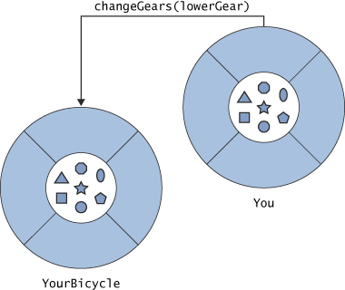
OO Basics - Message

Slide 26
OO Basics - Message
The figure shows the three parts of a message :-
The object to which the message is addressed (YourBicycle)
The name of the method to perform (changeGears)
Any parameters needed by the method (lowerGear)

Slide 27
OO Basics - Message
Messages provide two important benefits :-
An object's behavior is expressed through its methods, so (aside from direct variable access) message passing supports all possible interactions between objects.
Objects don't need to be in the same process or even on the same machine to send messages back and forth and receive messages from each other.

Slide 28
OO Basics - Class
A class is a blueprint or prototype that defines the variables and the methods common to all objects of a certain kind.

Slide 29
OO Basics - Class
What Is a Class?
In the real world, you often have many objects of the same kind.
For example, your bicycle is just one of many bicycles in the world.
Using object-oriented terminology, we say that your bicycle object is an instance of the class of objects known as bicycles.

Slide 30
OO Basics - Class
Bicycles have some state
(current gear, current cadence, two wheels)
and behavior (change gears, brake) in common.
However, each bicycle's state is independent of and can be different from that of other bicycles.
When building them, manufacturers take advantage of the fact that bicycles share characteristics, building many bicycles from the same blueprint. It would be very inefficient to produce a new blueprint for every bicycle manufactured.

Slide 31
OO Basics - Class
In object-oriented software, it's also possible to have many objects of the same kind that share characteristics like :- rectangles, employee records, video clips, and so on.
Like bicycle manufacturers, you can take advantage of the fact that objects of the same kind are similar and you can create a blueprint for those objects.
A software blueprint for objects is called a class.

Slide 32
OO Basics - Class
The class for our bicycle example would declare the instance variables necessary to contain the current gear, the current cadence, and so on for each bicycle object.
The class would also declare and provide implementations for the instance methods that allow the rider to change gears, brake, and change the pedaling cadence.

Slide 33
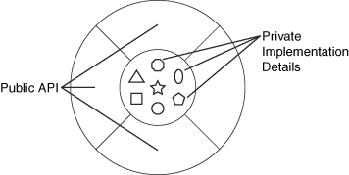
OO Basics - Class
The bicycle class.

Slide 34
OO Basics - Class
After you've created the bicycle class, you can create any number of bicycle objects from that class.
When you create an instance of a class, the system allocates enough memory for the object and all its instance variables.
Each instance gets its own copy of all the instance variables defined in the class.

Slide 35
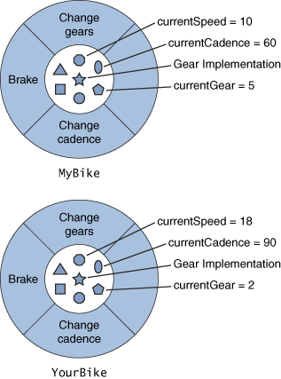
OO Basics - Class
MyBike and YourBike are two different instances of the Bike class.
Each instance has its own copy of the instance variables defined in the Bike class but has different values for these variables.

Slide 36
OO Basics - Class
In addition to instance variables, classes can define class variables.
A class variable contains information that is shared by all instances of the class.
A class can also declare class methods .
You can invoke a class method directly from the class, whereas you must invoke instance methods on a particular instance.

Slide 37
OO Basics – Class – vs - Object
The illustrations of objects and classes look very similar.
And indeed, the difference between classes and objects is often the source of some confusion.
It's a little more difficult to differentiate classes and objects in software.
This is partially because software objects are merely electronic models of real-world objects or abstract concepts in the first place.
But it's also because the term object is sometimes used to refer to both classes and instances.

